Slide 1

Quick Assistance
Vinay Jaibheem
Pranoop Mutha
Lakshmi Mrudula Chamala
Dinesh Tirumandyam

Slide 2
Objective
Motivation: There are a number of people with skill and expertise but not communication skills and place to find a job. They need some global crowd sourcing marketplace where the potential employers to post jobs and hire employees can show case their skills to promote themselves and complete the work more efficiently and economically.
Delivers knowledge and expertise exchange between people where no real currency is involved.

Slide 3
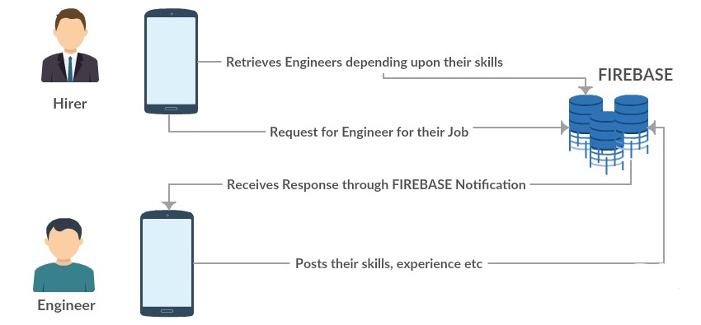
ARCHITECTURE

Slide 4







Technology

Slide 5
Features
Helps the hirers to find engineers of a particular technology
Helps the engineers to post their skills related to their work based on their technology.
The engineers can give their previous project details as a part of professional experience which will be helpful for the hirers to know more about the engineer.
Engineer can also upload their profile pic.
Notification for Forgot Password
Notification for Engineer after the Hirer has recruited.

Slide 6
Future Scope
Integrating Bitcoin API which can be used for virtual currency.
Watching some Technology Videos from which they can gain some points.

Slide 7


